Slide 1
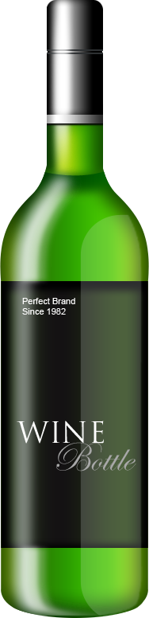
Level detection of wine bottles by camera
Innovation in sensortechnology
Project by Stijn Boutsen & Leendert Wilms

Slide 2
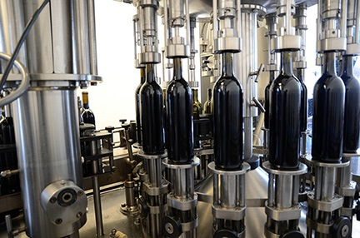
Introduction
Automated bottling process
Consistent filling
Need for Quality control
Large equipment
Expensive
Not portable
Project by Stijn Boutsen & Leendert Wilms

Slide 3
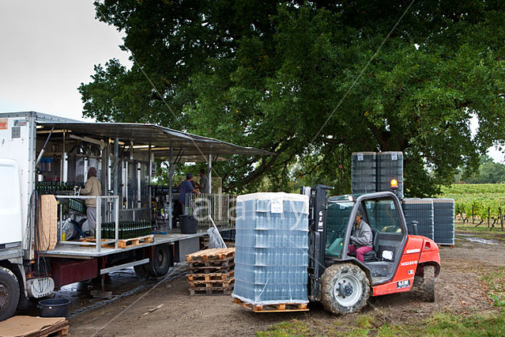
Mobile filling station
Future of wine bottling
Mobile plant
Onsite bottling
Cost efficiënt
Problem:
No room for fill level detector
Project by Stijn Boutsen & Leendert Wilms

Slide 4
Mobile filling station
Future of wine bottling
Mobile plant
Onsite bottling
Cost efficiënt
Problem:
No room for fill level detector
→ Smaller detectors
Project by Stijn Boutsen & Leendert Wilms

Slide 5
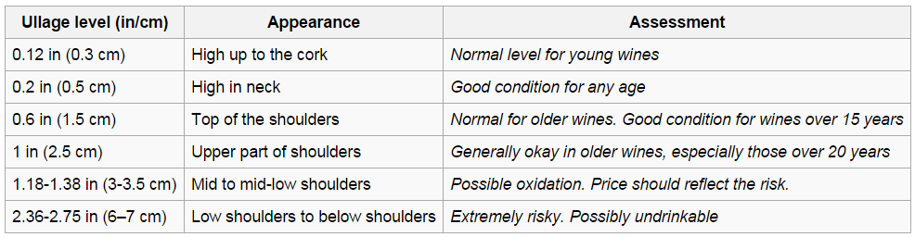
Ullage
= Unfilled space in a container
Consistent level = happy customer
Indicates state of the wine
Important for resellers/auction houses
Project by Stijn Boutsen & Leendert Wilms

Slide 6
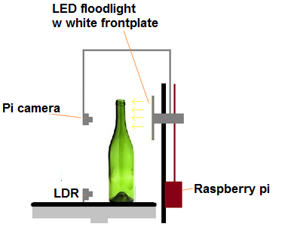
Portable level detection of wine bottles
Raspberry Pi
Camera module (Pi NOIR)
LDR
LED
Project by Stijn Boutsen & Leendert Wilms

Slide 7
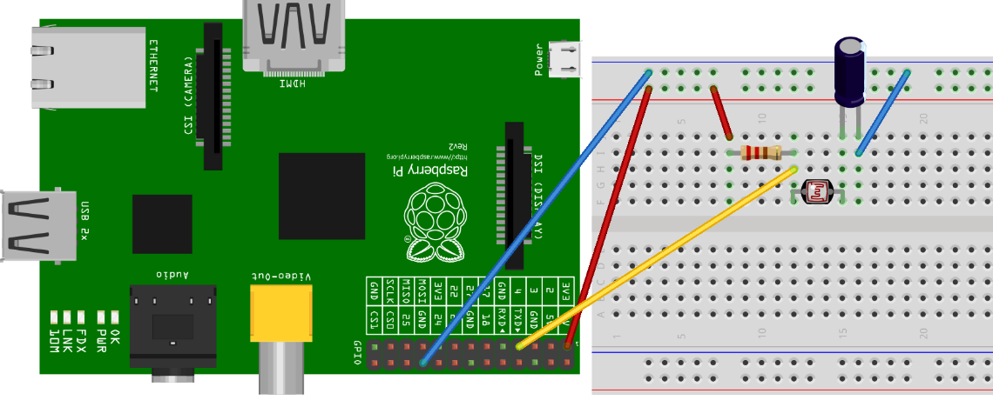
Reading LDR
LDR without ADC
Charge/discharge circuit.
Τ = R*C
1cycle → charge capacitor
Count cycles until capacitor is discharged.

Slide 8
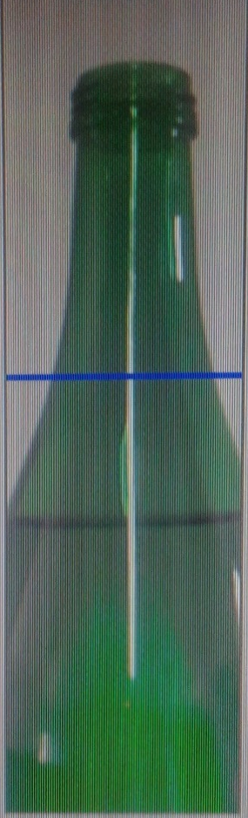
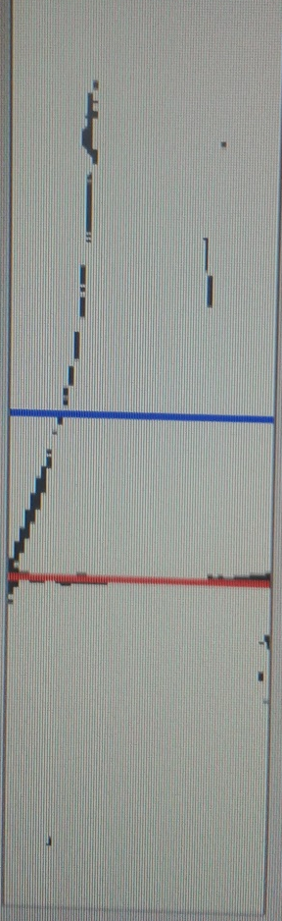
Results
Left = original image
Right = image after processing
Blue line = wanted level
Red/green line = measured level
Project by Stijn Boutsen & Leendert Wilms

Slide 9
Conclusion
Level detection with cheap setup
Portable system
Project by Stijn Boutsen & Leendert Wilms

